Slide 1
MY EXCEL JOURNEY
Victor Momoh

Slide 2
Victor Momoh
Excel Enthusiast
Started off at Excel 95
Professionally using Excel since 2007
Certified Microsoft Excel 2010 Expert
Excel and VBA Trainer
~ 4000 + posts on MrExcel.com
Run(with other experts) a Telegram group called “Nigerian Excel Users (NEU)”
Specialties include “Advanced Excel array formulas and VBA for developing solutions to solve everyday problems
Passionate about teaching

Slide 3
=DATEDIF(“First use”,TODAY(),”Y”)
1995:
First use of Microsoft Excel
2008:
Real life use and deeper dives
2010:
Advanced formulas, Features, VBA
2012:
Joined MrExcel.Com Officially
2015:
Became a Certified Microsoft Excel Expert
2020:
Started “ExcelMoments” Youtube cahnnel
For I = 1 to Infinity
Learn, Unlearn, Relearn------Think, Teach
Next I

Slide 4
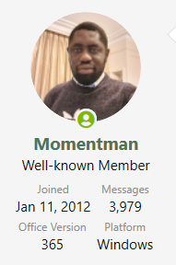
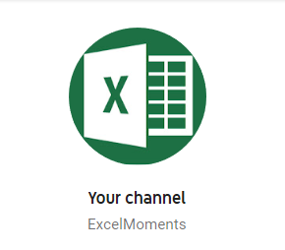
Trace Precedents ☺ How Did I get here?
Excel Videos
Online Forums
Ask
Books
Projects
Knowledge Sharing
https://www.youtube.com/channel/UCg9lOzPOQfjs_GoMlzSm_ww

Slide 5
Thank You

